Slide 1
Cancers Diangnosis Project
An Mobile Application with Three Cancers in hand
Supervisor: Dr. Sara Elmetwally
Name: AbdelRahman Ibrahim Karawia

Slide 2
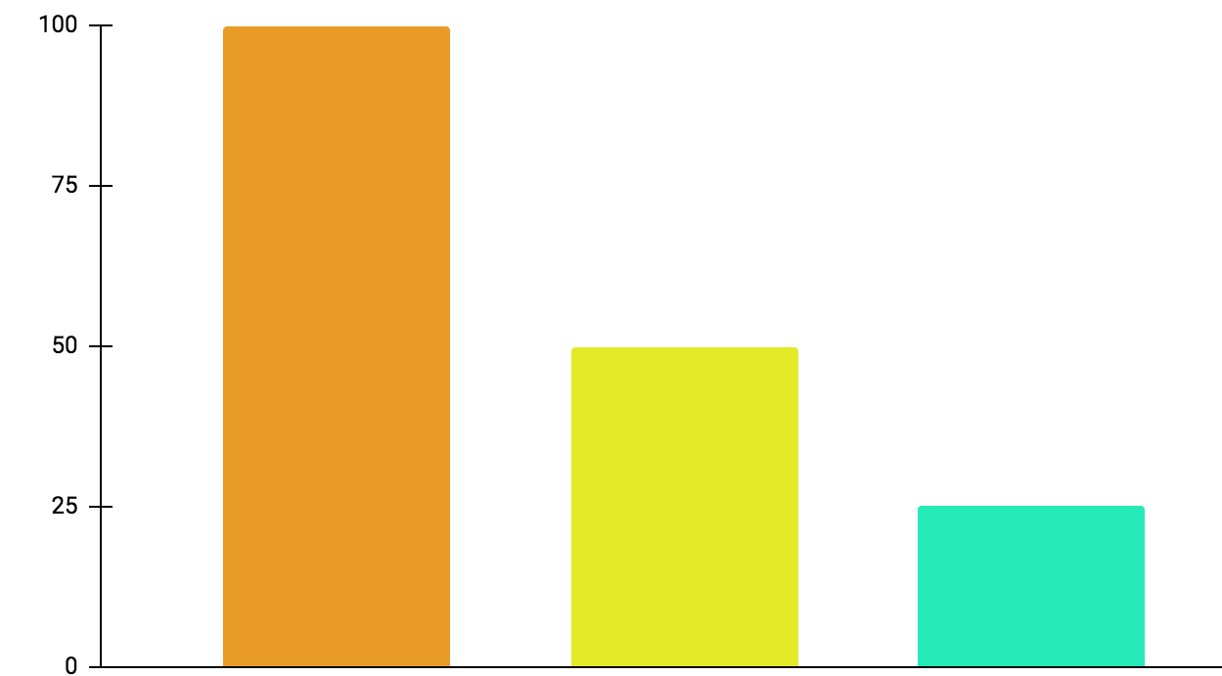
Research Motivation
Cancer is a leading cause of death worldwide, accounting for nearly 10 million deaths in 2020, or nearly one in six deaths.
01
Breast
2.26 million New Cases
02
Colorectal
1.93 million New Cases
03
Skin
1.2 million New Cases
Breast
Colorectal
Skin

Slide 3
Research Motivation
The number of cases for every cancer or tumor changes significantly but its not all about the number of each case yearly, it’s about the death rate for each one as well.
01
Colorectal
916,000 deaths
02
Breast
685,000 deaths
03
Skin
450,000 deaths
Colorectal
Breast
Skin

Slide 4
Algorithms and Techniques, Classical vs DeepLearning
01
02
ML Classical Algorithms
Deep Learning Algorithms
SVM, KNN, Decision Tree, … etc.
ANN: CNNs, RNNs, plain NN, … etc.

Slide 5
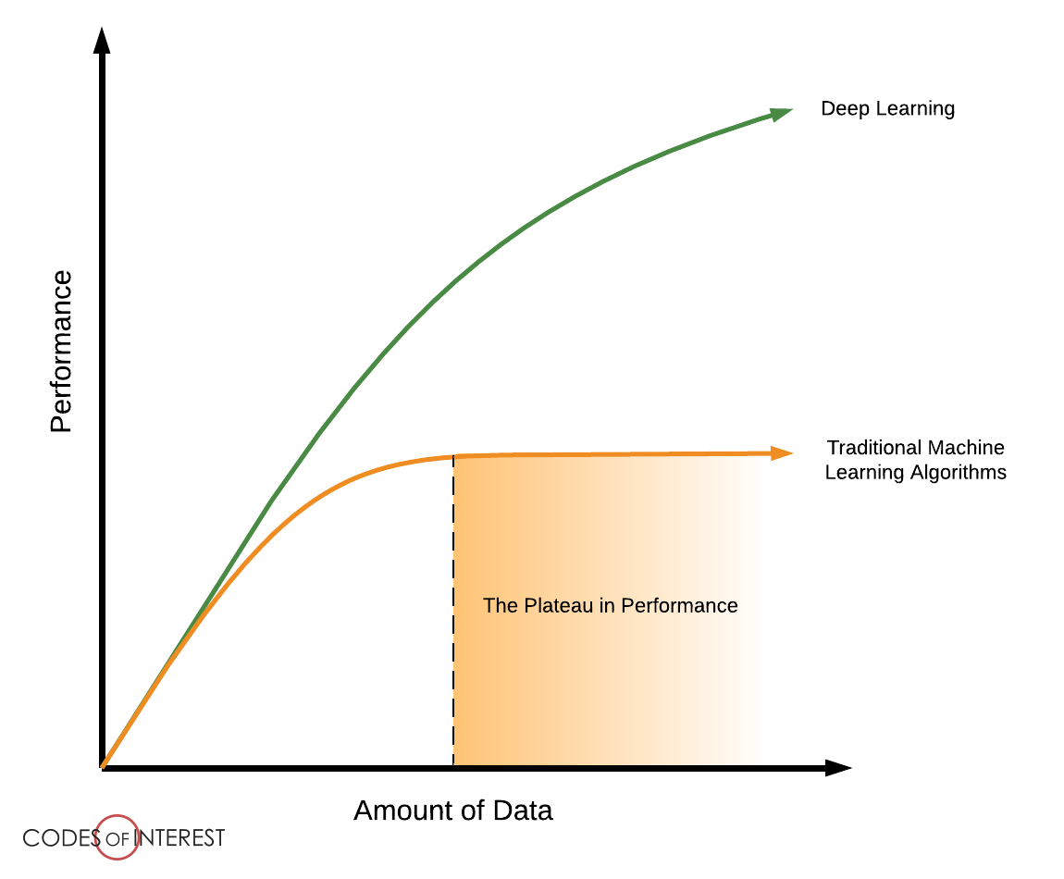
Algorithms and Techniques, Classical vs DeepLearning
Performance of Classical ML and Deep Learning with Data Increasing

Slide 6
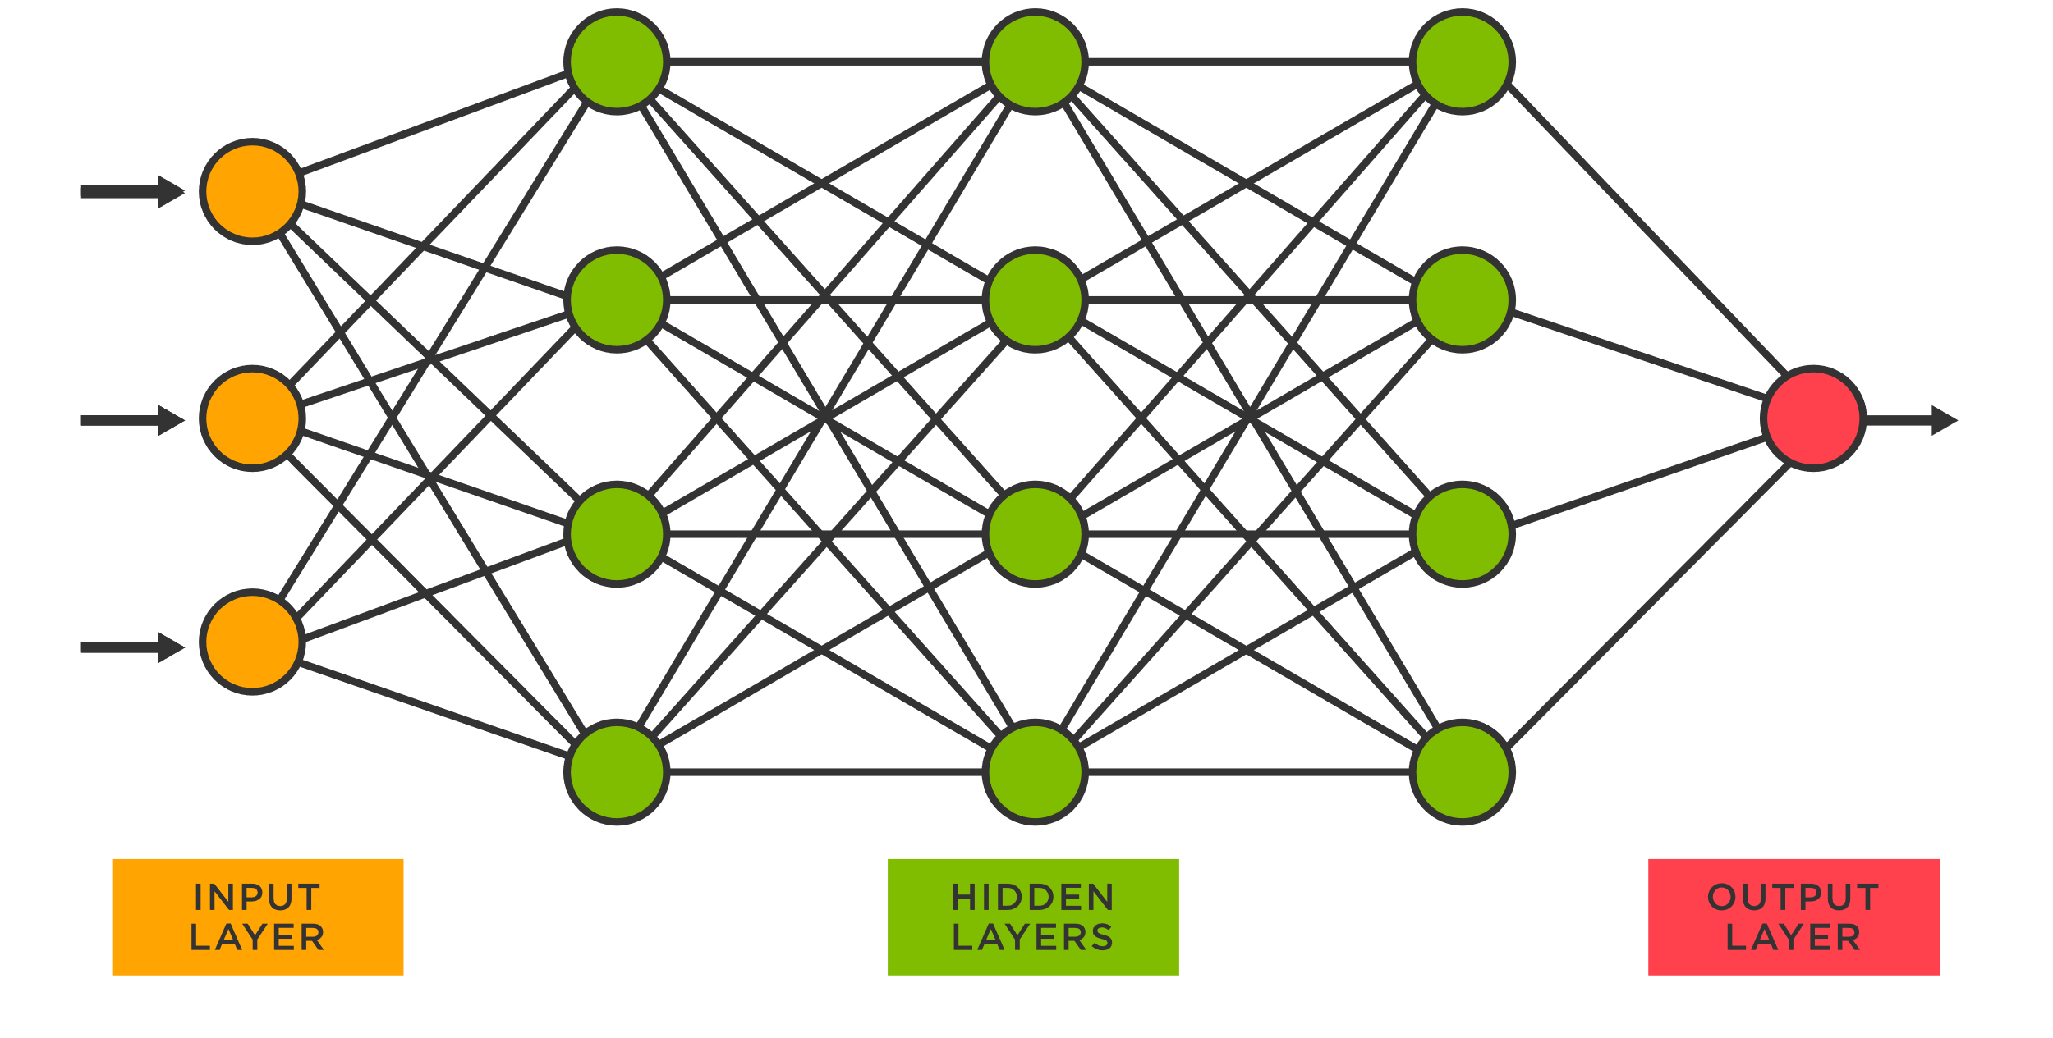
Algorithms and Techniques, Plain Neural Network
The number of input in the previous layer is equal to the number of parameters of that node which are going to be trained, therefore it has a huge number of parameters to train.

Slide 7
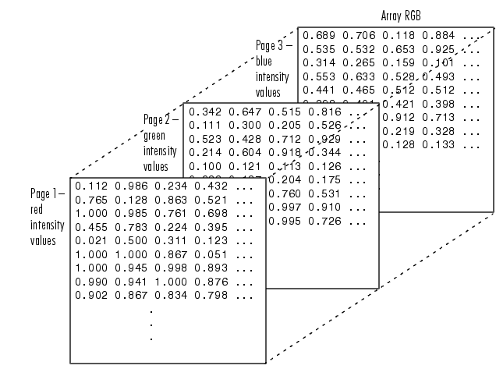
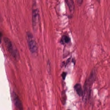
Algorithms and Techniques, Image as input for plain NN
Image input for the input layer converts to and multi-dimensional array (none, 200, 200, 3)

Slide 8
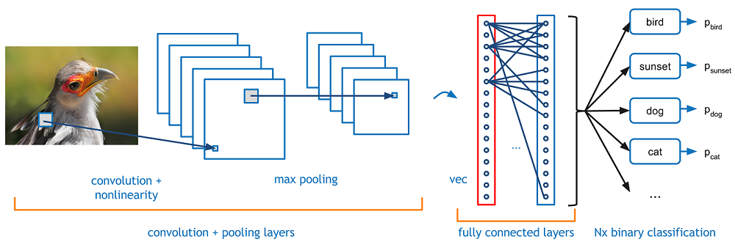
Algorithms and Techniques, CNN
CNNs are regularized versions of multilayer plain NN. Multilayer NN usually mean fully connected networks, on a scale of connectivity and complexity, CNNs are on the lower extreme.

Slide 9
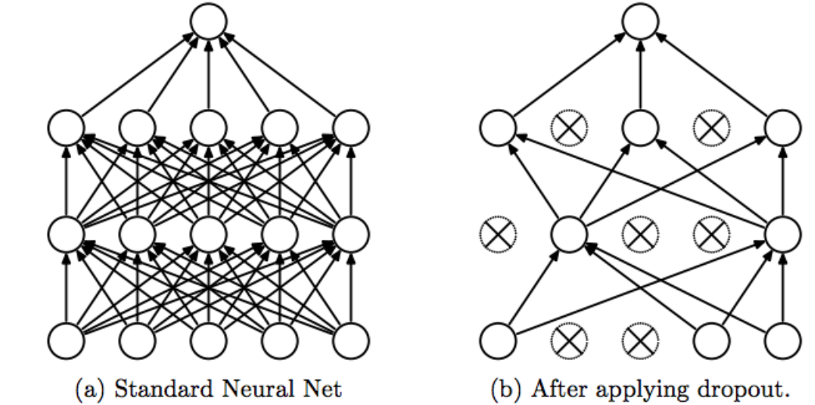
Algorithms and Techniques, Dropout Technique
In terms or Regularization, Dropout Technique is splendid technique to perform that task, there also L1 and L2 but Dropout is our main regularization technique for our project.

Slide 10
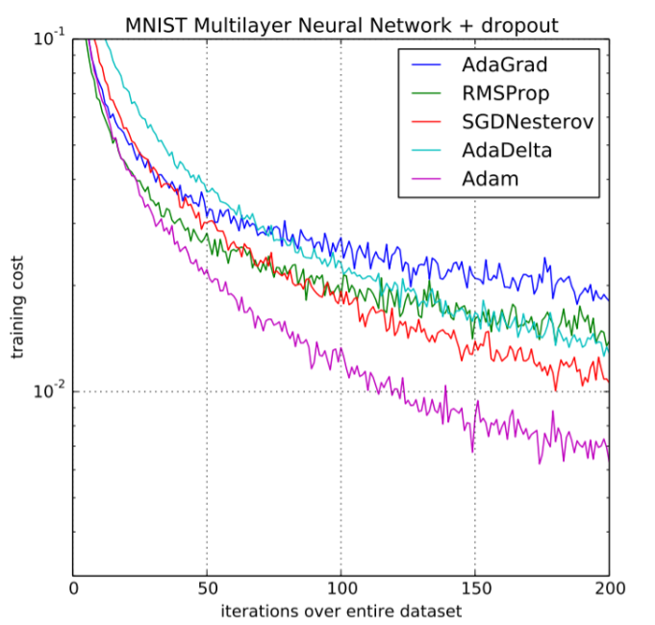
Algorithms and Techniques, Adam Optimizer
The method is efficient when working with large problem involving a lot of data or parameters. This algorithm is used to accelerate the gradient descent algorithm by taking into consideration the ‘exponentially weighted average’ of the gradients.

Slide 11
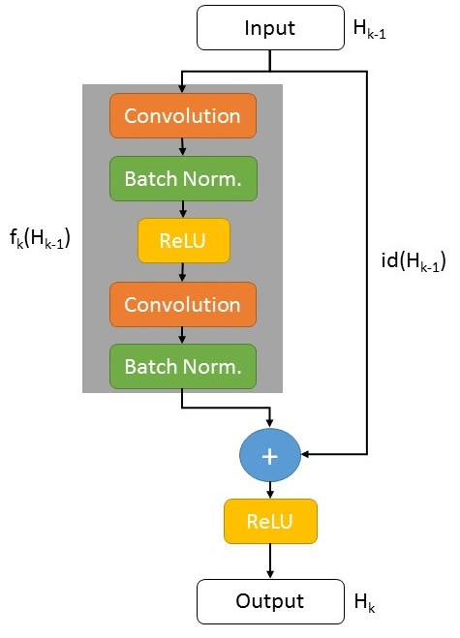
Algorithms and Techniques, RESNET Architecture
CNN architectures is increasing in blocks exponentially, but Exploding/vanishing gradients happens but Residual Network or skipping connections helps to eliminate this problem.
ResNet-101 is a convolutional neural network that is 101 layers deep.
Batch normalization: applies a transformation that maintains the mean output close to 0 and the output standard deviation close to 1.

Slide 12
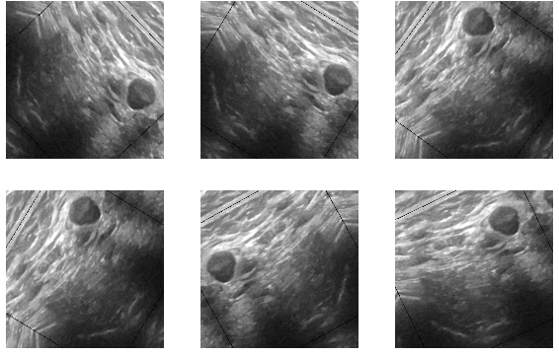
Algorithms and Techniques, Augmentation Technique
Making your data bigger and more reliable model by processing image like flipping or rotation, important for our project as we expect camera-based image.
Flipping Method and Rotation only

Slide 13
Process Cycle
01
02
03
Data Preprocessing
Architecture
Initialization
Cleaning, labeling, splitting, and balancing Data
Choosing best model to work on
Create resonable set of hyperparameters
04
05
Train the model
Tuning Step
Train with specified number of iterations
Loop over this cycle to get appropriate hyperparameters

Slide 14
Cancers Project Covering
The project handle three cancers
Breast Cancer
Multi-Class Model [8]
Skin Cancer
Multi-Class Model [3]
Multi-Class Model [8]
Colorecral Cancer
Multi-Class Model [8]

Slide 15
Breast Cancer
Binary Classification Benign and Malignant
Multi-Class Classification Densities Involved
Vs
Only Benign and Malignant class
Not considering breast dense
High accuracy but tricky
Fast, less computational time
Benign and Malignant with 4 dense
8 classes 4 benign and 4 malignant
General, Indicates possible problem
More Computation time

Slide 16
Breast Cancer
01
Benign
Breast Cancer Classes
Malignant
02
Density 1
Density 1
03
Benign
Malignant
04
Density 2
Density 2
05
Benign
Malignant
06
Density 3
Density 3
07
Benign
Malignant
08
Density 4
Density 4

Slide 17
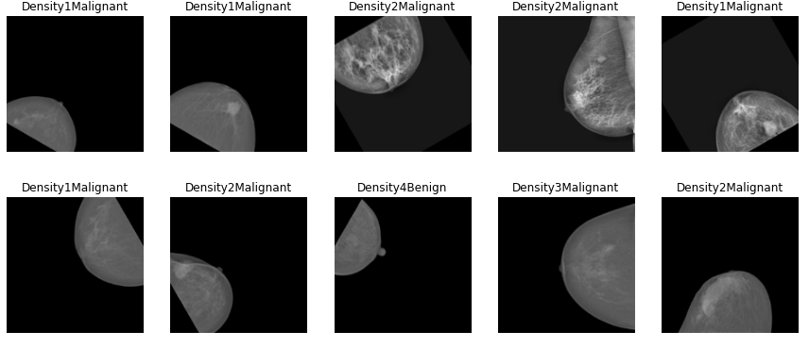
Breast Cancer
Mammogram images dataset contains about 7800 images, 6000 of them to be trained using ResNet101 model.

Slide 18
Breast Cancer, Process
Results
The model
After many ideas we got final best possible results
Semi-Pretrained ResNet Model with techniques
Preprocesses Images
Hyperparamter Tuning
Image preprocessing to be trained well
Important step to get best results

Slide 19
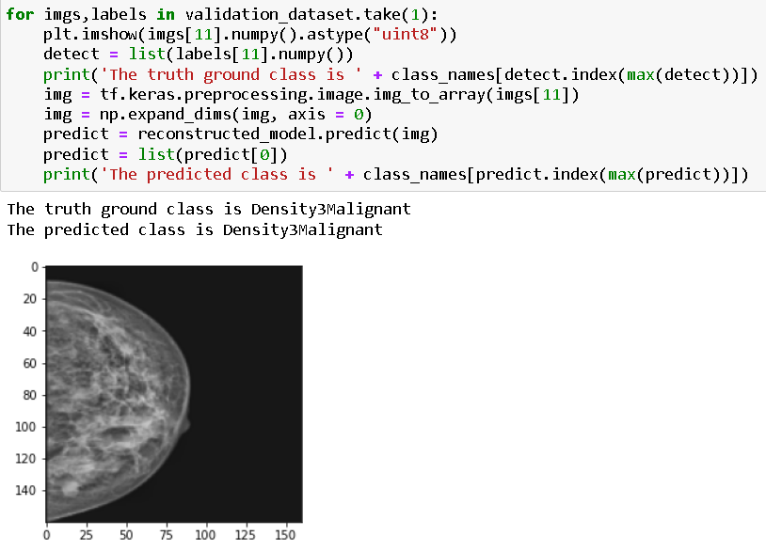
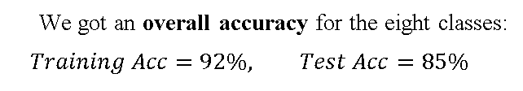
Breast Cancer, Results
Results
We got an overall accuracy for the eight classes:
$$Training Acc=92\%, Test Acc=85\%$$
After many ideas we got final best possible results
Overall, the sensitivity of mammography is about 87 percent. This means mammography correctly identifies about 87 percent of women who truly have breast cancer in real life.

Slide 20
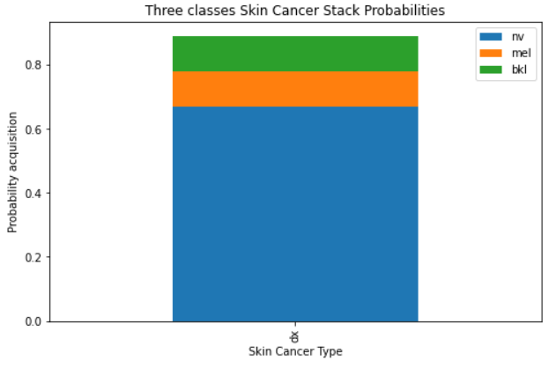
Skin Cancer, Imbalnced Data
Number of Images for each Class
Melanocytic Nevi (nv) | 6705 Images
Melanoma (mel) | 1113 Images
Benign lesions of the keratosis (bkl) | 1099 Images

Slide 21
Skin Cancer, Imbalnced Data
Over, Under Sampling
Class Weighting
Vs
Duplicates minor class images
Removes major class images
Duplicates causes overfitting
Removing causes information loss
More attention on minor classes
Increasing minor class weights
No explicit formula to work with
Reliable abd effective

Slide 22

Skin Cancer, Class Weighting & Image Raio
$$\begin{aligned}&class weights=\frac{1}{examples_{class}}∗\frac{examples_{total}}{number of class}−const\#\end{aligned}$$
Image width to height ratio was 1.3333 (600,450) px originally, at first, but it might affect model learning somehow as skin cancer diagnosis is very sensitive to lesion diameter and dimensions. Therefore, we kept that ratio in other iteration (200,150) px which leads to higher rates of learning and slightly better accuracy with less epochs.
Class Weighting
This Formula isn’t Rigid
Const to be determined by tuning
Const is considered as hyperparameter
No big increase in accuracy
Accuracy is not our estimator here.

Slide 23
Skin Cancer, Results
Results
After many ideas we got final best possible results
$$\text{Overall} \text{Validation} \text{Accurac}y=80 \%$$
Skin cancer is one of the most frequently misdiagnosed types of cancers. Around 25% of skin cancer cases are misdiagnosed, hence there’s a limitation here.

Slide 24
Colorectal Cancer
01
Adipose Tissue
Colorrectal Cancer
Classes 625 Images Each
Immune Cell Conglomerates
02
03
Complex Stroma
Mucosal Glands
04
05
Debris and Mucus
Simple Stroma
06
07
Empty
Tumor Epithelium
08

Slide 25
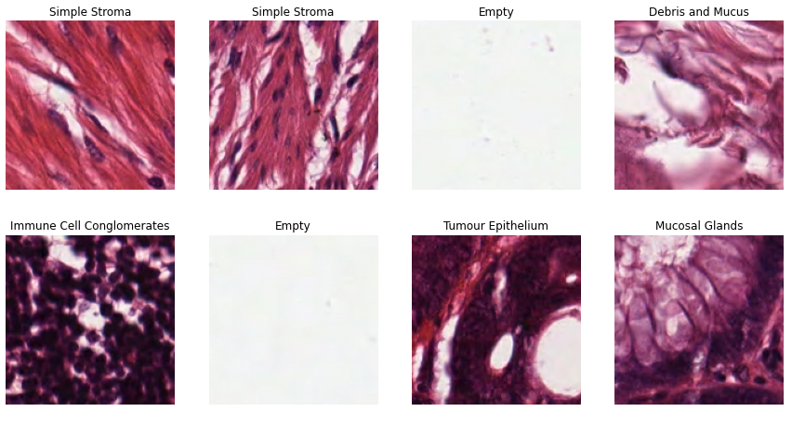
Breast Cancer
histological images of human colorectal cancer. All images are RGB, This dataset consists of 5000 images for 8 classes 625 image (150, 150) px each class (Balanced).

Slide 26
Colorectal Cancer, Results
Results
After many ideas we got final best possible results
$$\text{Overall} \text{Validation} \text{Accurac}y=89 \%$$
Using ResNet101 Model with categorical cross entropy for loss, and apply augmentation with flipping and rotations as well, we got an overall training accuracy about 98 percent, and precision 98.5 and validation accuracy 89 percent and precision 88.6 percent

Slide 27
Deployment
01
AI software
04
Compact the model
Creaitng Flutter Framework for App UI
02
Framework
Convert the model
05
Tensorflow used to train model
Converting to API to be used for Flutter
03
Train the model
06
Integrate the model
Training Model
Integrating the API with Flutter

Slide 28
Further Work
 | More to do …
01 | Number of Cancers | Increase the number of classifiers (Cancers) in the application
02 | Architechtures | We must try other architectures other than ResNet101 and MobilNetv2
03 | Skin Cancer Imbalance Data | Rather than class weighting, try replace under and over sampling with augmeting minor classes
04 | Make use of uploaded images | We can take the uploaded image and classify it and added to the database with other trained images to improves the number of images to be trained.

